Slide 1
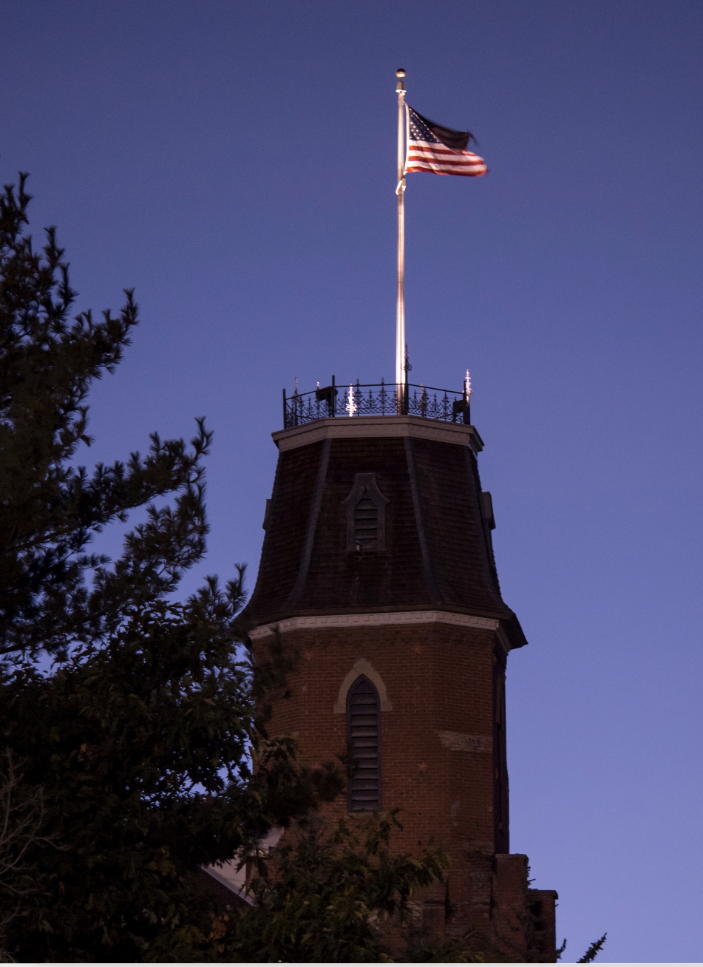
Cyberinfrastructure knowledge, practices, and challenges among researchers in the Rocky Mountain Advanced Computing Consortium
Andrew Monaghan
Research Computing
University of Colorado Boulder
Brett Milash
Center for High Performance Computing
University of Utah
Mara Sedlins
CSU Libraries
Colorado State University

Slide 2
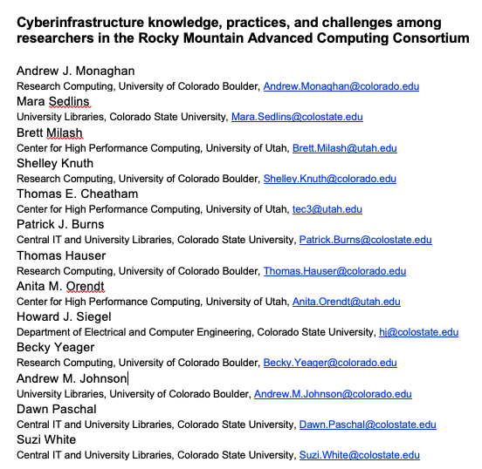
Acknowledgements

Slide 3
Outline
Overview
Survey methods
Results
Summary
Lessons learned
Discussion

Slide 4
Overview

Slide 5
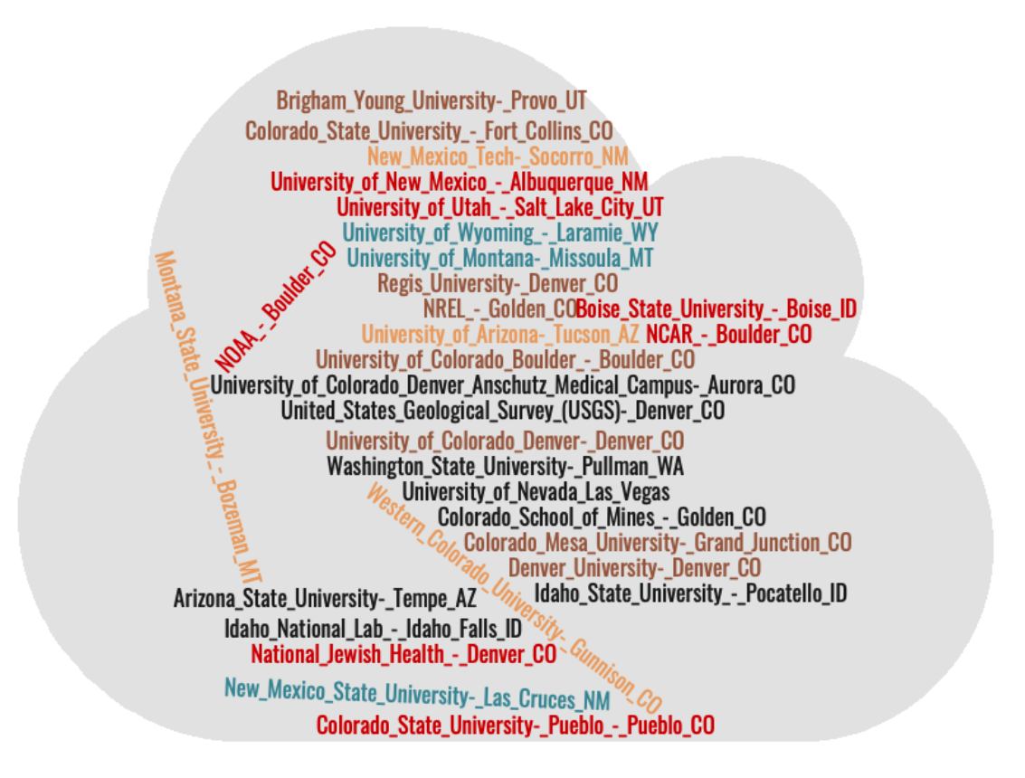

RMACC Cyberteam
The Rocky Mountain Advanced Computing Consortium (RMACC)
RMACC is a collaboration among academic and research institutions located throughout the intermountain states.
Mission: widespread effective use of high performance computing.
The University of Colorado, Colorado State University, and the University of Utah formed the RMACC “Cyberteam” in 2017 to facilitate cyberinfrastructure support for RMACC researchers.

Slide 6
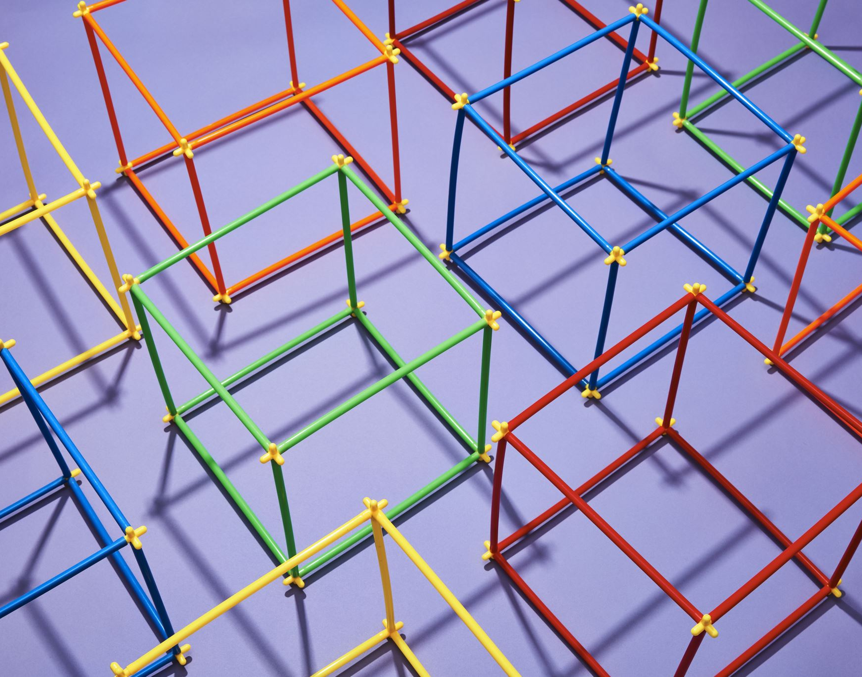
Cyberinfrastructure
“Cyberinfrastructure consists of computing systems, data storage systems, advanced instruments and data repositories, visualization environments, and people, all linked together by software and high-performance networks to improve research productivity and enable breakthroughs not otherwise possible.”
(Craig A. Stewart, Stephen Simms, Beth Plale, Matthew Link, David Y. Hancock, and Geoffrey C. Fox. 2010. What is cyberinfrastructure. In Proceedings of the 38th annual ACM SIGUCCS fall conference: navigation and discovery (SIGUCCS '10). ACM, New York, NY, USA, 37-44. DOI=10.1145/1878335.1878347 http://doi.acm.org/10.1145/1878335.1878347)

Slide 7

Objectives
The RMACC Cyberteam works to enhance cyberinfrastructure-related access, engagement and training among RMACC researchers.
To better understand how to meet these objectives, the RMACC Cyberteam recently conducted focus groups and online surveys with RMACC researchers.

Slide 8
Survey Methods

Slide 9
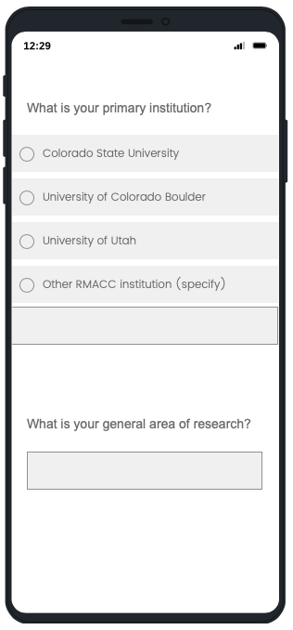
Topics covered
Institution and research focus
Data sensitivity
Data storage
Data archiving and sharing
Data transfer
Computing
Data visualization
Workflows
Software use
Barriers
Interactions with CI staff

Slide 10
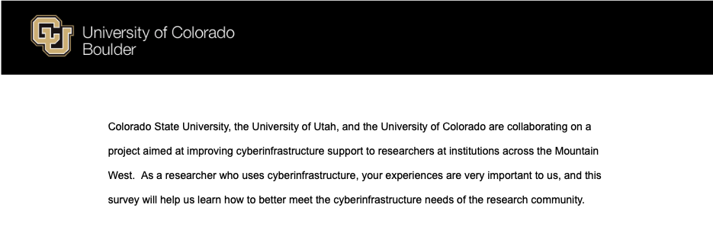
Survey Details
Platform: Electronically via Qualtrics →
Survey period: March-May 2020
Responses anonymous
Inclusion criteria:
Active high performance computing account at CU, CSU or U. Utah, or;
Persons subscribing to cyberinfrastrucure- or data-oriented list-serves at these three institutions, or;
Researchers at RMACC institutions (via list-serve)
IRB: Submitted to the Institutional Review Board at CU, CSU and U. Utah and deemed Exempt (Cat. 2)
Questions presented as combination of ”radio button”, ”check boxes” and open-ended (fill in)
Analysis of results conducted in R v3.6.3

Slide 11
Survey Results
Nomenclature:
UU = University of Utah
CU = University of Colorado Boulder
CSU = Colorado State University
RMACC = Other RMACC institutions
95% Uncertainty Margins:
±25% (N≅15 respondents)
±10% (N≅100 respondents)
±5% (N≅300 respondents)

Slide 12
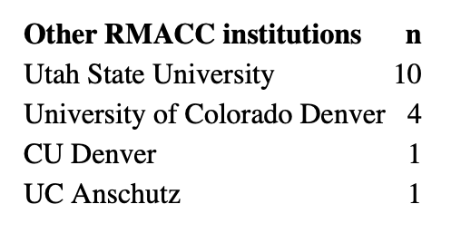
Responses by institution
All Institutions
N=323

Slide 13
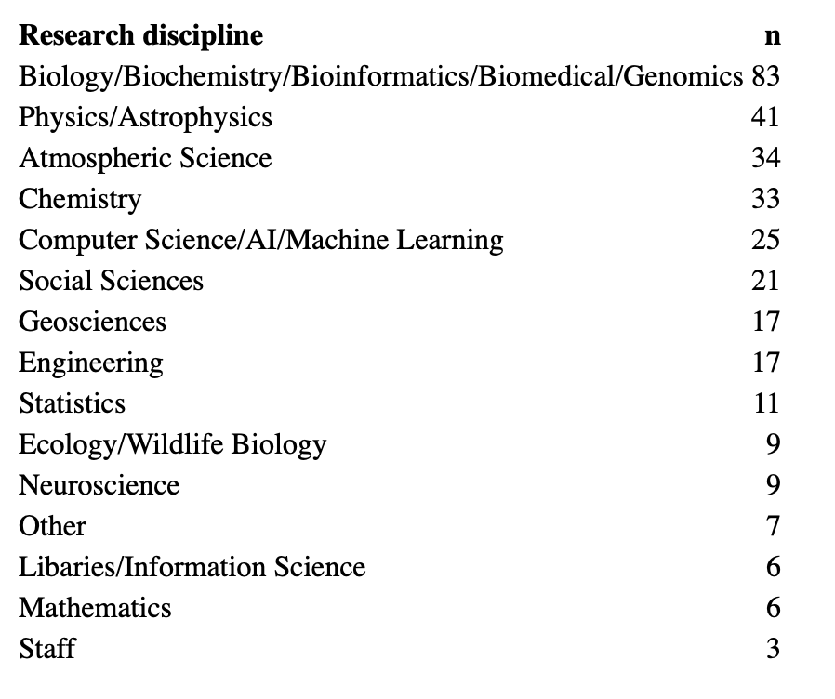
Responses by discipline
All Institutions
N=323

Slide 14
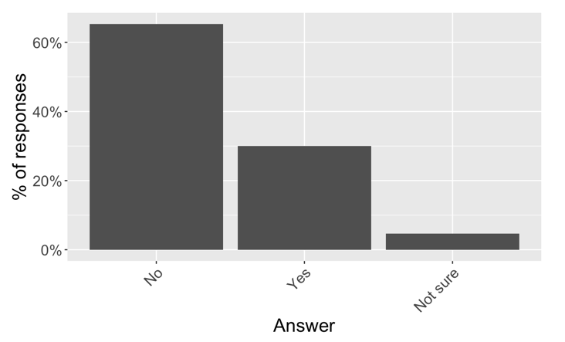
Sensitive data usage
Do you work with private, restricted, sensitive or confidential data?
All Institutions
N=323

Slide 15
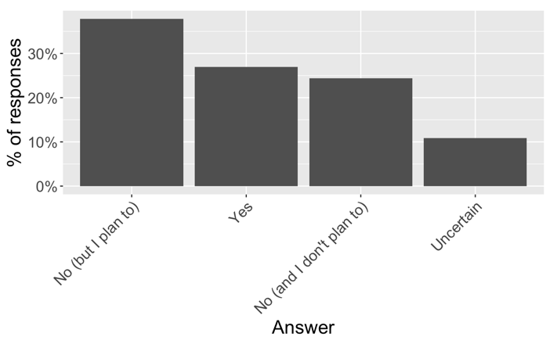
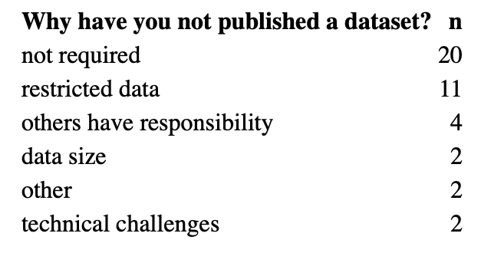
Data Publication
Have you published a dataset?
All Institutions
N=267

Slide 16
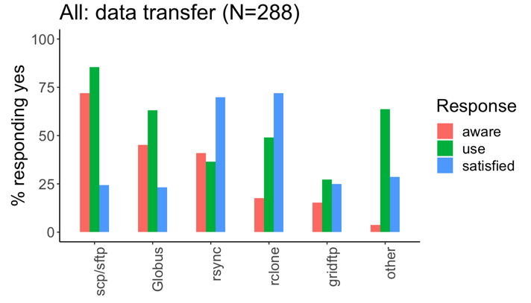
Awareness, Usage: Data transfer resources
Responses across all institutions to questions about awareness, use, and satisfaction with various data transfer resources.

Slide 17
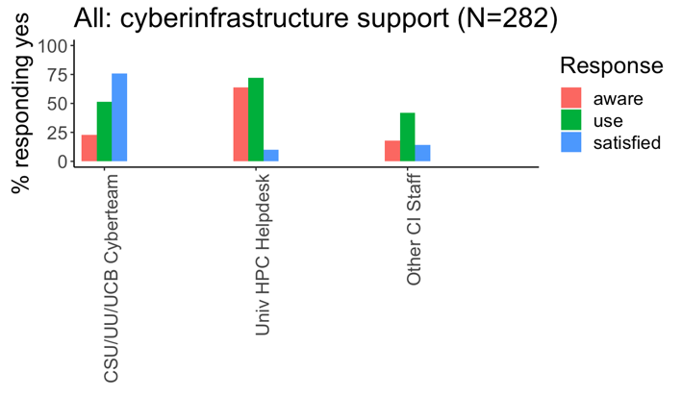
Awareness, Usage, Satisfaction: People with CI knowledge
Responses across all institutions to questions about awareness, use, and satisfaction with various CI support personnel.

Slide 18
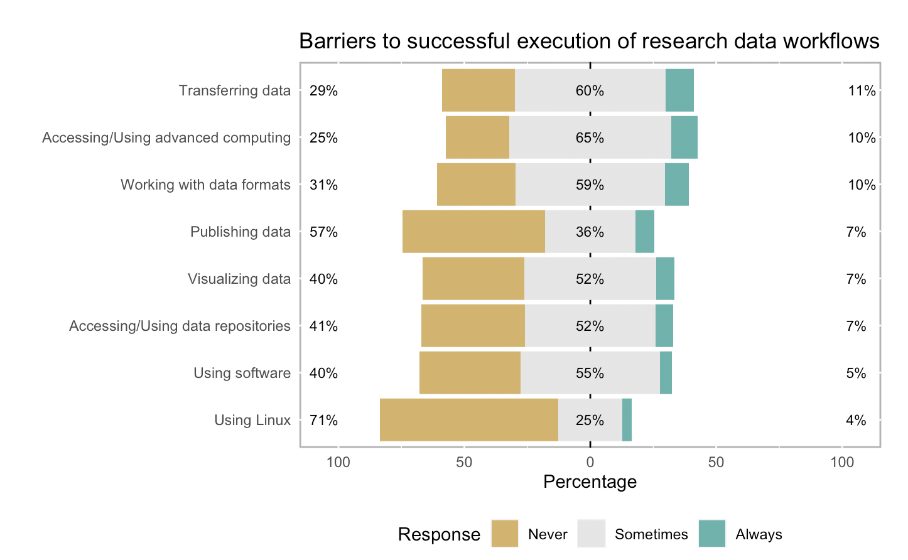
Barriers to success
All Institutions
N=218

Slide 19
Summary
Some of the most fundamental aspects of cyberinfrastructure use are sometimes or always a barrier to successful execution of research data workflows for >70% of respondents.
Access to cyberinfrastructure
Transferring data onto/off of cyberinfrastructure
Satisfaction rates with the workflow-oriented support from RMACC Cyberteam facilitators compared to other forms of user support are remarkably high, about 75% on average, compared to about 5% to 50% for university high performance computing help desks.
Focused efforts to remove basic barriers and bolster workflow facilitation may provide dividends in terms of increasing use of cyberinfrastructure and, ultimately, enhancing research capabilities and output.
Data and survey available at: osf.io/g3hjs
Contact: Andrew.Monaghan@Colorado.edu; Brett.Milash@Utah.edu; Mara.Sedlins@colostate.edu

Slide 20

Discussion
Questions/comments about the methods?
Questions/comments about the results?
What might you have done differently?
What’s your favorite pizza topping?

Slide 21

Lessons Learned
Questions with Likert-type scales worked well.
Participant’s may take liberties with questions involving numbers and units (e.g., ‘Gigabytes’).
Use checkboxes with caution.
Less is more.
We didn’t pursue reasons for dissatisfaction.

Slide 22
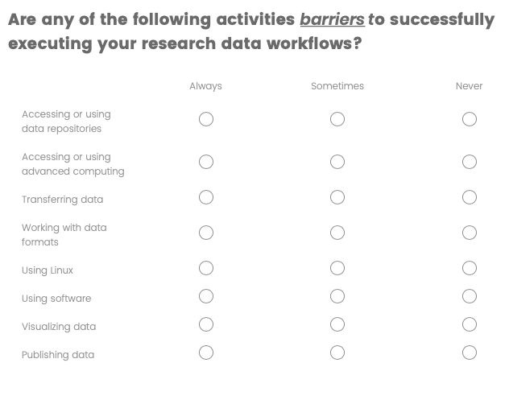
Lessons Learned
The good…

Slide 23
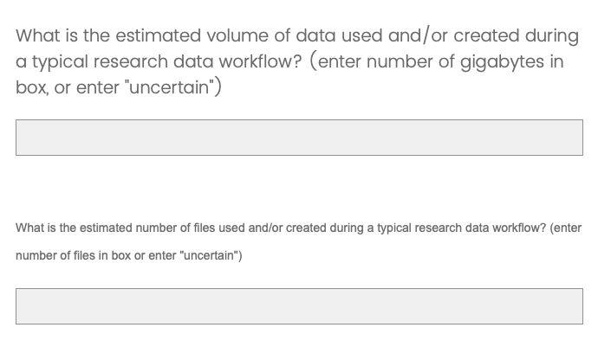
Lessons Learned
The bad…

Slide 24
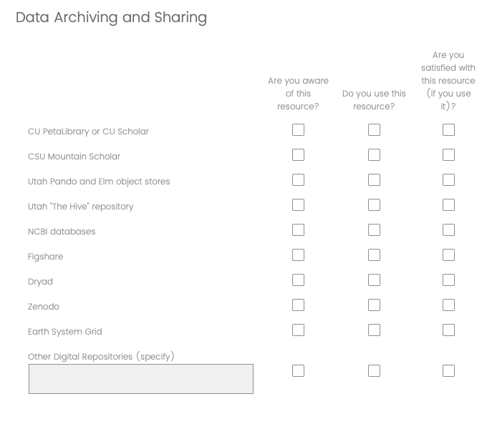
Lessons Learned
The ugly…

Slide 25
Additional Slides

Slide 26
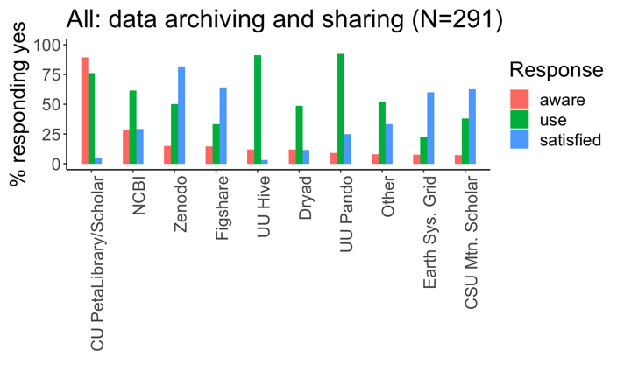
Awareness, Usage: Data archiving and sharing resources
Responses across all institutions to questions about awareness, use, and satisfaction with various data archival and sharing resources.

Slide 27
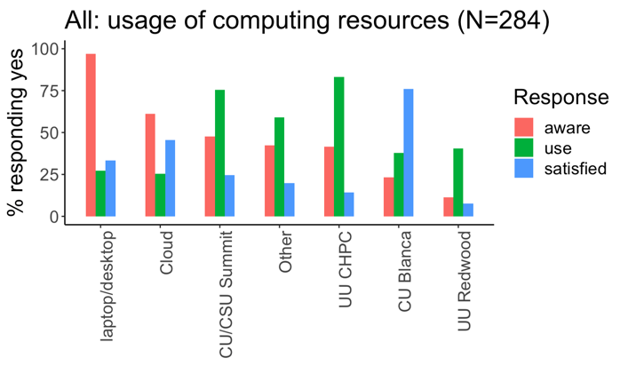
Awareness, Usage: Computing resources
Responses by institution to questions about awareness, use, and satisfaction with various computational resources for data analysis.

